Slide 1
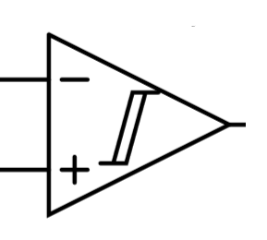

Design Overview: one processing unit
Industrial CMOS sensor
(front-end integrated)
Vdd
Options:
Sony: IMX273 / IMX287
OnSemi: python series
Teledyne: EV76C560 / EV76C570
MSPM0C1104 microcontroller
one “pixel”
comp flag
global I/O
registers
enable flag
$$\overline{E}$$
neighbour I/O & register values
A/D bus

Slide 2
Design Overview: overall architecture
pixel unit
pixel processor
···
···
···
N pixels
···
···
···
···
···
Himax HX6537-A
Pixel Array Microprocessor
···
···
A/D bus 1
N pixels
Pixel array
···
A/D bus k

Slide 3
Model | Resolution (pixels) | Pixel Size (µm) | Optical Format | Max Frame Rate (fps) | Output Interface(s) | Notes
Sony IMX273 | 1456 × 1088 (~1.58 MP) | 3.45 × 3.45 | 1/2.9″ (~6.3 mm) | ~226.5 (10-bit mode) | Sub-LVDS / MIPI (varies) | Low-noise, high-speed, common in inspection
Sony IMX287 | 728 × 544 (~0.4 MP) | 6.9 × 6.9 | 1/2.9″ (~6.3 mm) | ~436.9 (10-bit mode) | Sub-LVDS / MIPI (varies) | Large pixels, high sensitivity, good in NIR / low light
OnSemi PYTHON1300 | 1280 × 1024 (1.3 MP) | 4.8 × 4.8 | 1/2″ | ~210 (LVDS) / ~43 (parallel) | LVDS (multi-lane) / parallel | supports ROI, programmable gain, CDS.
OnSemi PYTHON5000 | 2592 × 2048 (~5.3 MP) | 4.8 × 4.8 | ~1″ | Up to ~100 (Zero ROT mode) | LVDS (e.g., 8-lane) | Higher resolution, suited for machine vision with high data bandwidth.
Teledyne EV76C560 | 1280 × 1024 (1.31 MP) | 5.3 × 5.3 | 1/1.8″ | ~60 full res (VGA/cropped >100) | Parallel 10-bit | Dual shutter modes, WDR/HDR, ROI, defect correction.
Teledyne EV76C570 | 1600 × 1200 (~2.0 MP) | 4.5 × 4.5 | 1/1.8″ | ~50 full res | Parallel 10-bit | 2 MP variant, good low-light and dynamic range features.

Slide 4
Design Overview: overall architecture v2.0
OV5640
···
FPC
DVP
PIO
···
RP2354A
Inter-FPC connection
Strengthened FPC
Pin Header
PL: data receive
PS: data process
FPGA board
(pynq / zynq)

Slide 5
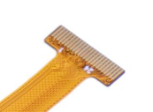
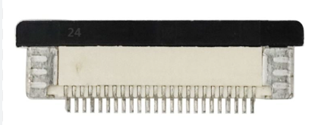
Layout Overview
ZIF Connector
Main FPC
Strengthened FPC
OV5640
(front)
BUCK/LDO
Vin
···
···
RP2354A
(back)
ASM330LHH
(back)
Pin Header to FPGA

